Slide 1
Choosing the safest business area in Denver

Slide 2
Introduction
The main objective of this project is to determine the safest place in terms of the criminal situation for opening a business in Denver, USA.
First, needed to choose the safest borough with a sufficient list of neighborhoods for business development by analysing crime data.

Slide 3
Data acquisition and cleaning
● Crime data in Denver from 1st January 2015 to 17 July 2020 from Kaggle dataset,
2018 data scraped from basketball-reference.com
● Boroughs and neighbourhoods in Denver from wikipedia,
2016-2017 data scraped from basketball-reference.com
● In total, 492611 rows and 19 features in the raw dataset.
● Cleaned data contains 5 features.

Slide 4
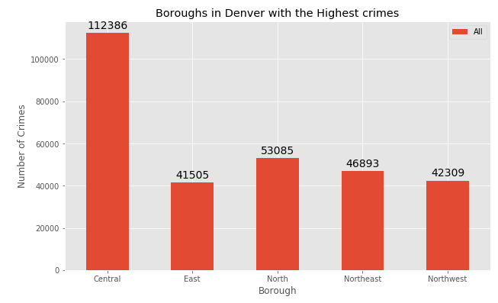

Slide 5
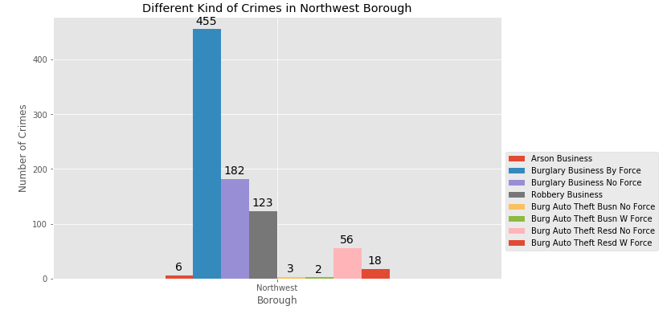
Different types of crime against business in Northwest

Slide 6
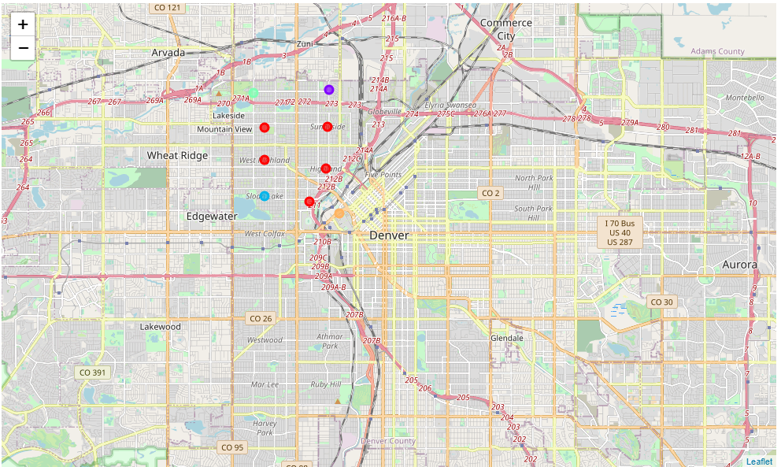
Clustered neighbourhoods in Nortwest with k-means approach

Slide 7
Conclusion and future directions
Purpose of this project was to identify Denver areas close to center with low crime level for opening there business in order to aid stakeholders in narrowing down the search for optimal location. By calculating most common venue in Northwest from Foursquare data we have first identified types of commercial places, and then generated extensive collection of locations which satisfy some basic requirements. Clustering of those locations was then performed in order to create major zones of interes and addresses of those zone centers were created to be used as starting points for final exploration by stakeholders.
Final decission on optimal restaurant location will be made by stakeholders based on specific characteristics of neighborhoods and locations in every recommended zone, taking into consideration additional factors like attractiveness of each location (proximity to park or water), levels of noise / proximity to major roads, real estate availability, prices, social and economic dynamics of every neighborhood etc.

